Slide 1
Final Project Proposal
Jonathan Chow

Slide 2
Sitemap
Index.html
cast.html
plot.html
trivia.html
trailers.html

Slide 3
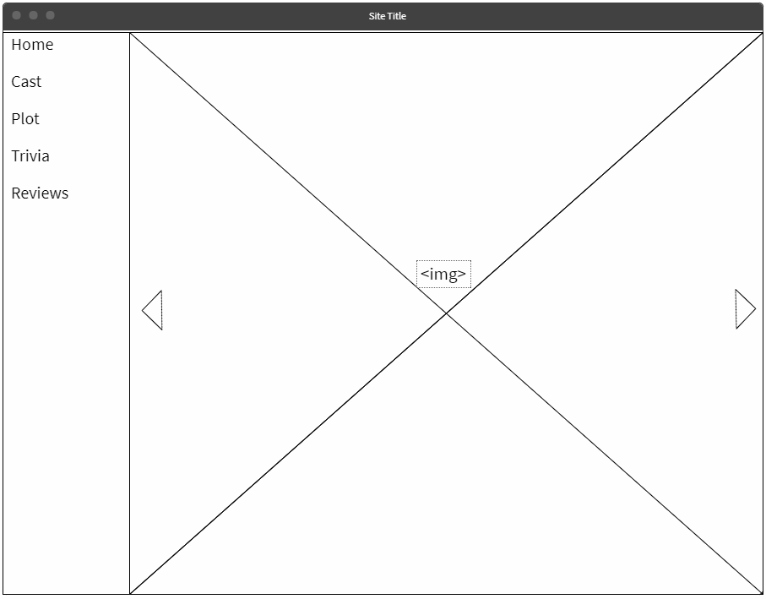
Wireframe

Slide 4
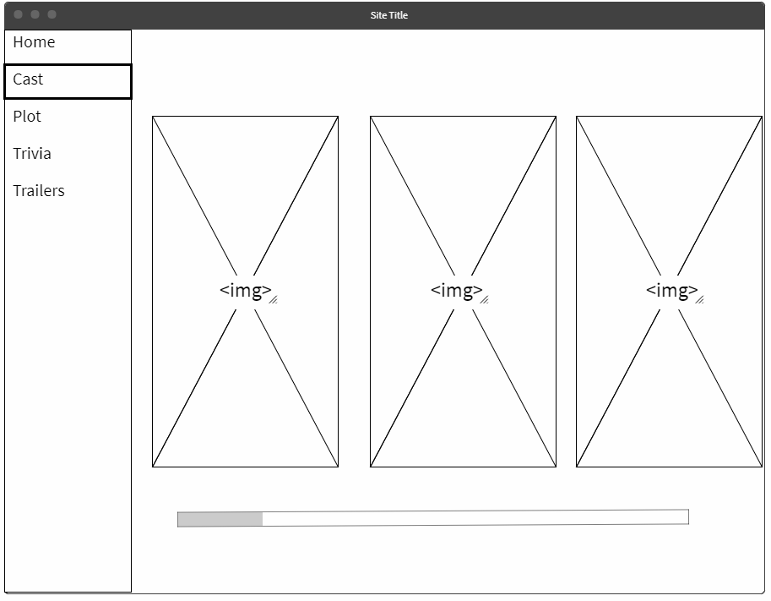
Wireframe

Slide 5
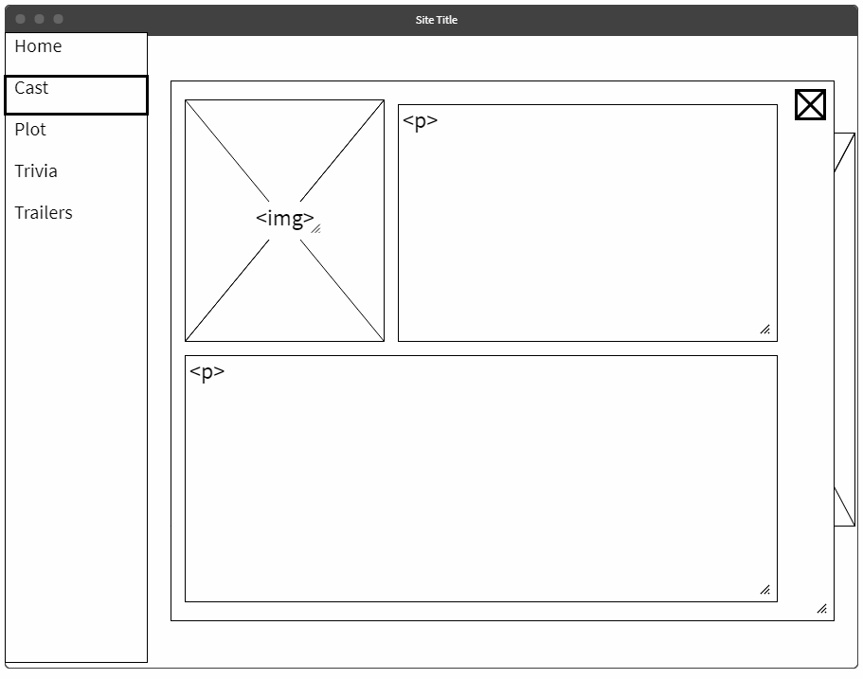
Wireframe

Slide 6
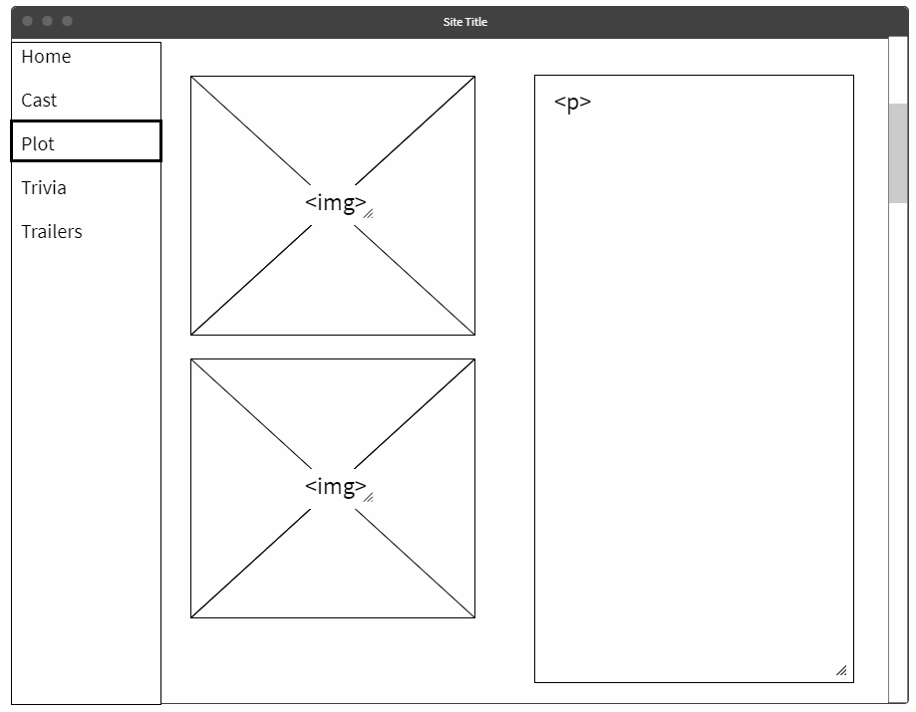
Wireframe

Slide 7
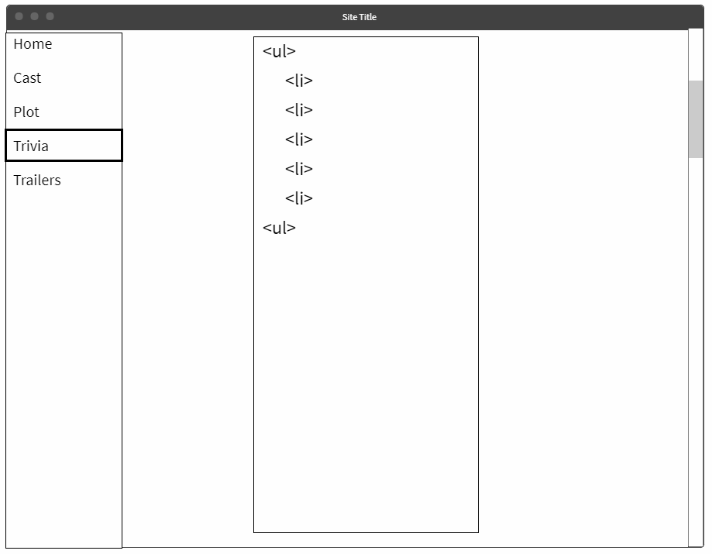
Wireframe

Slide 8
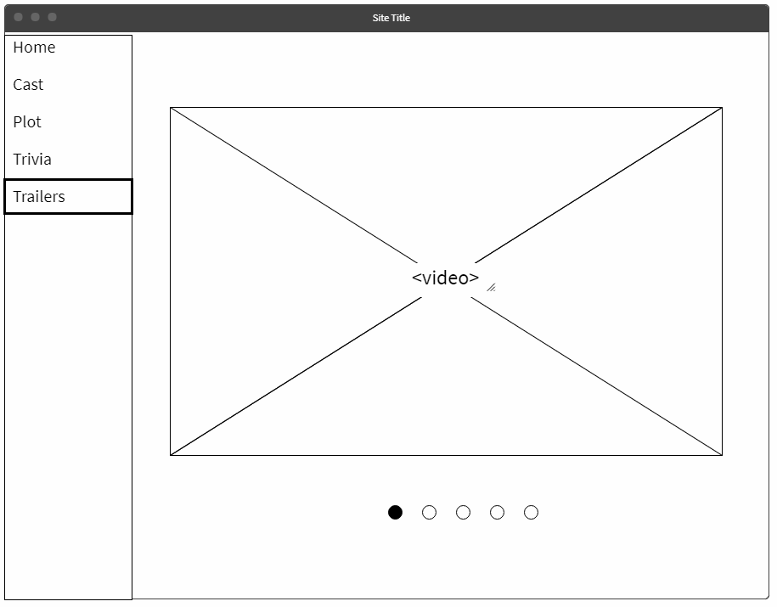
Wireframe

Slide 9
Todo List
Bootstrap for framework
Lightbox/Modal using JavaScript and jQuery
Embeded Youtube videos
Make preloader gif with p5.js
Animations between pages using CSS and smoothState.js

Slide 10
Themes
Black and white
Emptiness and space

Slide 11


